Slide 1
USDA Soybean and Nitrogen Fixation
Adaptation to Complete Our Mission
Planting season is the busiest and most important time for us. Unfortunately, this year it coincided with the Covid-19 pandemic. However, we were able to come up with creative ways to adapt to the situation and made the planting season a success while keeping the Safety and wellbeing of everyone our top priority.

Slide 2
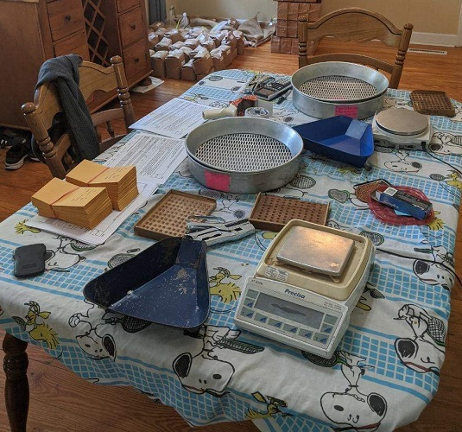
We minimized shared surface contamination by having everyone taking a set of items needed for seed packing including: a small scale, a 100-seed counting board, a calculator, a stapler, a triangle pan, and a pencil.

Slide 3
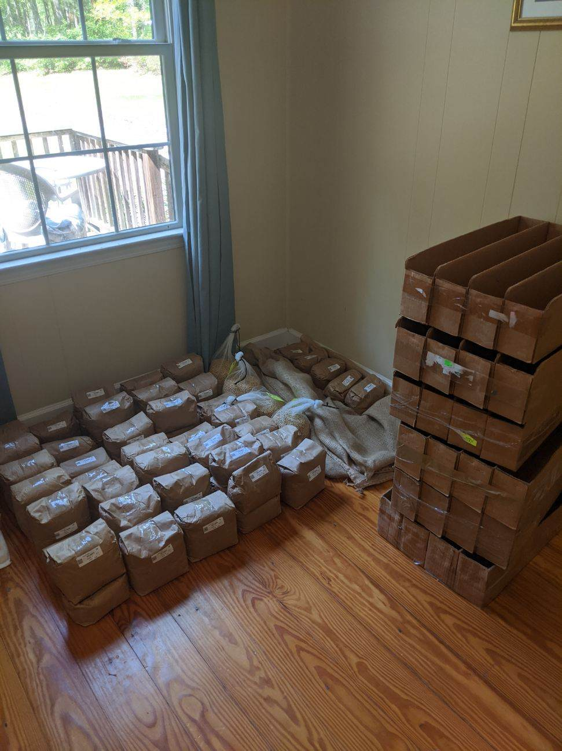
Seed preparation starts before packing. This step consists on sorting and lining up the seed source bags according to the list of entries form.

Slide 4
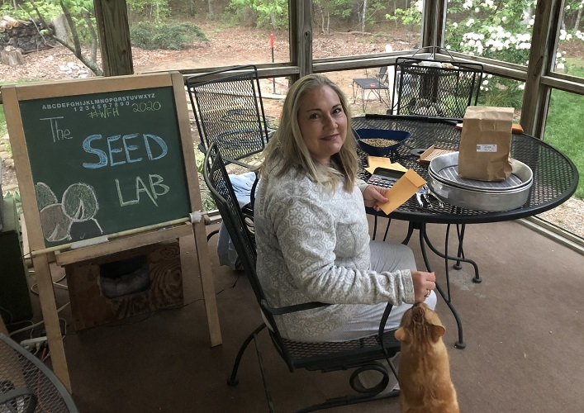
Everyone created their own unique, happy and social distanced “seed lab”.
Amy even trained her cat to assist in the seed packing process.

Slide 5
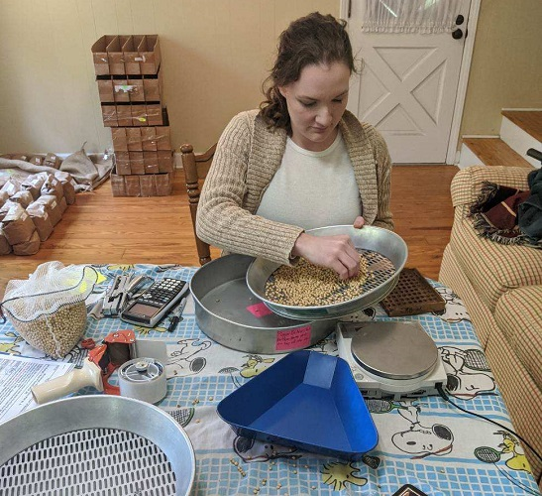
Seed need to be cleaned before packing:
a) hand sieve with graded mesh sizes (if mixtures /off- types vary in size) to separate slender and bold grains; and
b) examining the seed for any off-types, hilum color, purple stain, and damage seeds.
(Brittaney) is blissfully separating seed while listening to her favorite Disney soundtracks.

Slide 6
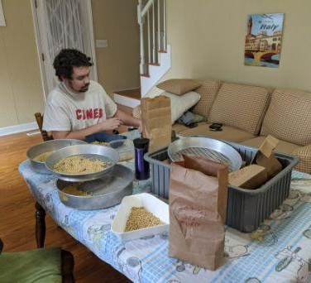
The amount of seeds to be packed, is determined by counting out 100 seeds (using the counter board) and weighing on a scale (g) and multiply that by the number of seeds per plot as indicated in list form
Paul is counting seed while dreaming about his dream vacation in Italy.

Slide 7
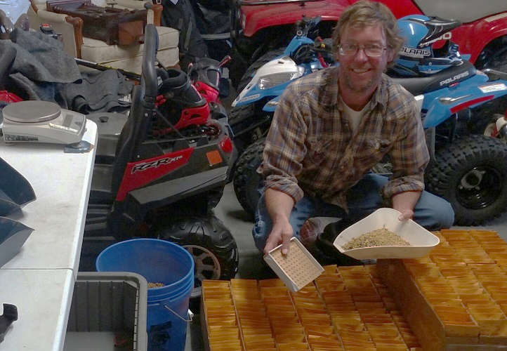
Jason rearranged his garage to make room for seed packing and planting preparation. He did promise all his ‘toys’ that he would take them out for a spin after the Covid-19 pandemic.

Slide 8
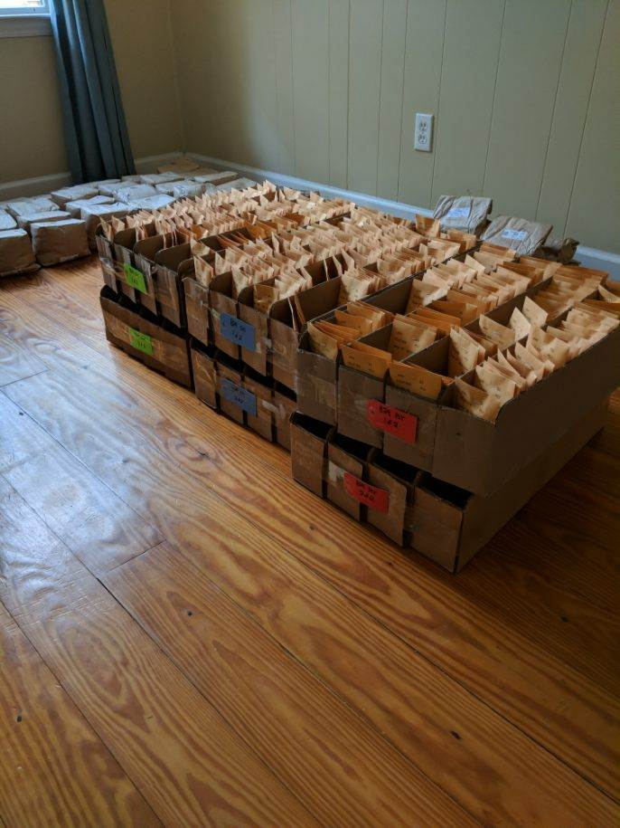
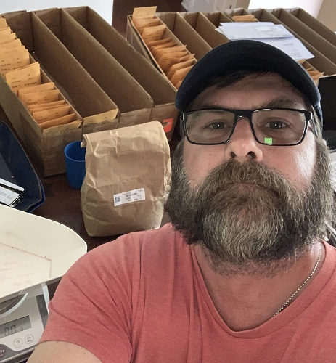
Once packed, the seed packets were sorted by consecutive plot numbers for planting.
There’s Cory saying it’s planting time!

